Slide 1
MM 225 – AI and Data Science Day 2: Probability and Random Variable
Instructors: Hina Gokhale, MP Gururajan, N. Vishwanathan
30 July 2024

Slide 2
Population and Sample
Population refers to collective of all objects or events under consideration
Examples:
Yield Strength of a Super alloy produced at XYZ
Hardness of Steel developed at ABC
Chemical composition of an alloy developed at PQR
Sample is a set of only few items selected from population randomly.

Slide 3
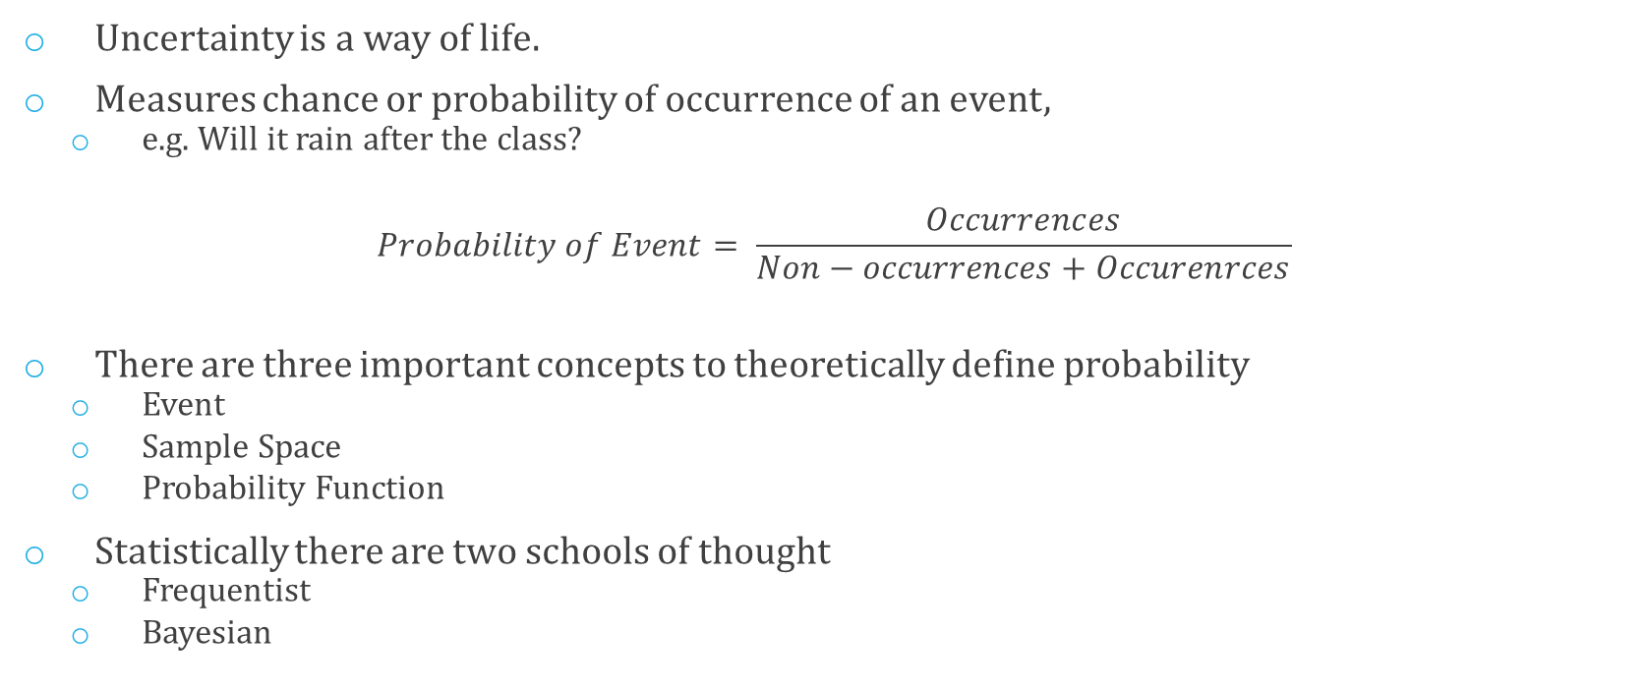
Probability as Measure of Uncertainty
Uncertainty is a way of life.
Measures chance or probability of occurrence of an event,
e.g. Will it rain after the class?
$$Probability of Event= \frac{Occurrences}{Non−occurrences+Occurenrces}$$
There are three important concepts to theoretically define probability
Event
Sample Space
Probability Function
Statistically there are two schools of thought
Frequentist
Bayesian

Slide 4
Some Definitions
An experiment can result in different outcomes, even though it is repeated under the same manner every time is a Random Experiment
Set of all possible outcomes of a random experiment is called the sample space of the experiment, and is denoted by S
S is discrete if it consists of finite or countable infinite set of outcomes.
S is continuous otherwise (i.e. it contains an interval of real numbers)
An event is a subset of S

Slide 5
Frequentist and Bayesian Probability
Frequentist probability is objective.
It is calculated by counting the frequency of occurrence of an event
Bayesian Probability is subjective.
It is assigned to events based on evidence and personal belief.
Based on Bayes Theorem …hence called Bayesian

Slide 6
Frequentist Definition of Probability
A function P(A) is defined as a probability of event A iff the following three are true:
P(A) >=0 for all A ∈ S
P(S) = 1
If A and B are two events and A ∩ B = ∅ then P(A ∪ B) = P(A) + P(B)

Slide 7
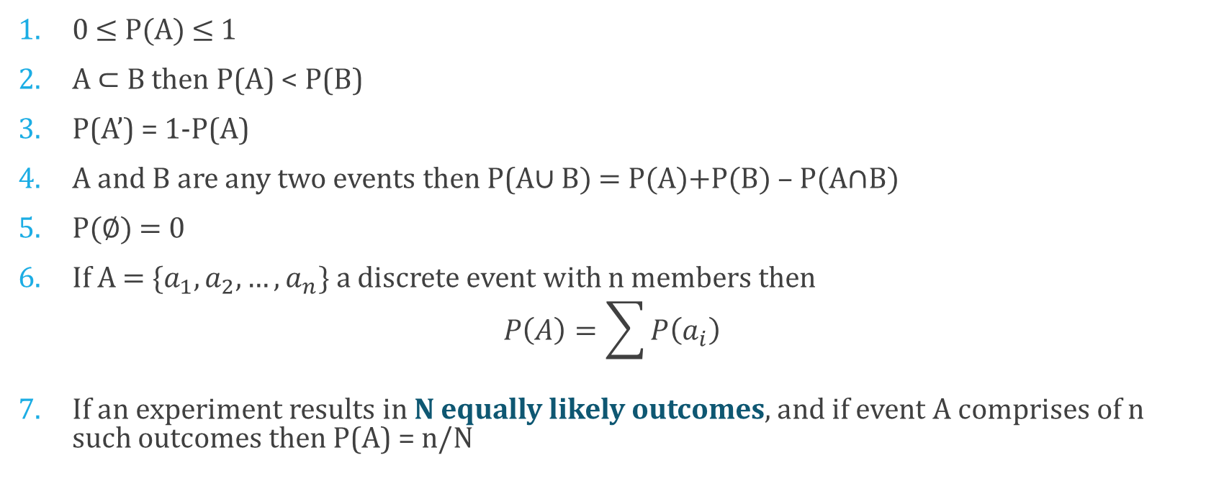
So we also have
0 ≤ P(A) ≤ 1
A ⊂ B then P(A) < P(B)
P(A’) = 1-P(A)
A and B are any two events then P(A∪ B) = P(A)+P(B) – P(A∩B)
P(∅) = 0
If A = {$a_{1}, a_{2}, …, a_{n}\}$a discrete event with n members then
$$P\left(A\right)=\sum{P\left(a_{i}\right)}$$
If an experiment results in N equally likely outcomes, and if event A comprises of n such outcomes then P(A) = n/N

Slide 8
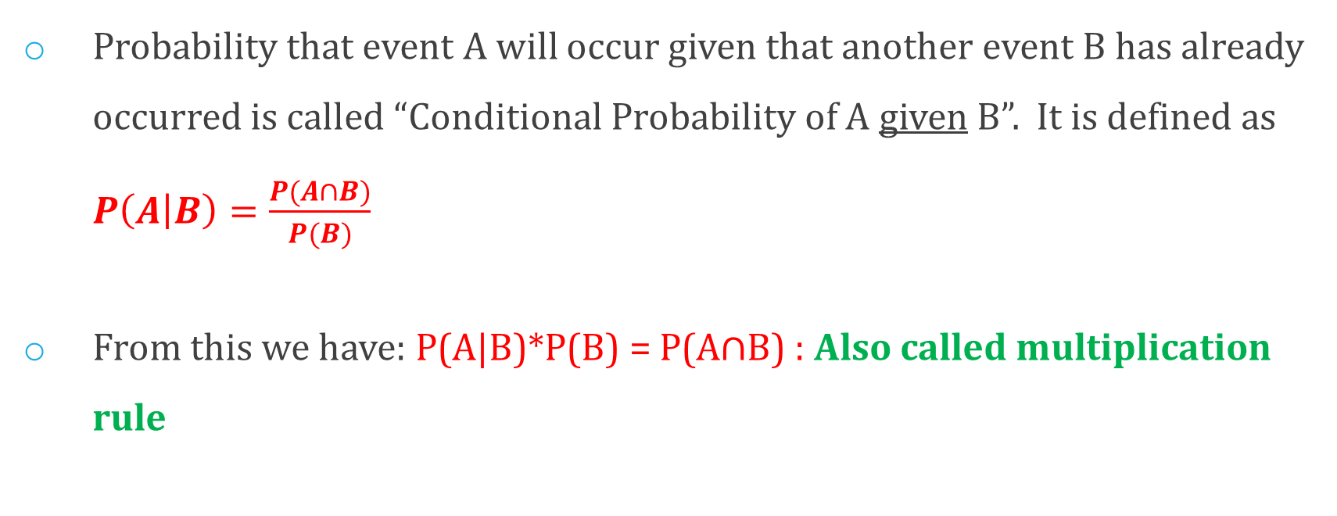
Conditional Probability
Probability that event A will occur given that another event B has already occurred is called “Conditional Probability of A given B”. It is defined as $P\left(A | B\right)=\frac{P(A∩B)}{P(B)}$
From this we have: P(A|B)*P(B) = P(A∩B) : Also called multiplication rule

Slide 9
Total Probability Rule
Just as we have: P(A|B)*P(B) = P(A∩B)
We also have: P(A|B’)*P(B’) = P(A∩B’)
A∩B and A∩B’ are two mutually exclusive sets, and (A∩B) U (A∩B’) = A
Therefore,
P(A) = P(A∩B) + P(A∩B’) = P(A|B)*P(B) + P(A|B’)*P(B’)

Slide 10
General form of TPR
P(A) = P(A∩B) + P(A∩B’) = P(A|B)*P(B) + P(A|B’)*P(B’)
Suppose: S = B₁ U B₂ U … U B_{n} and B₁, B₂, …, B_{n} are mutually exclusive sets, then we have
P(A) = P(A|B₁)*P(B₁) + P(A|B₂)*P(B₂) + …. + P(A|B_{n})*P(B_{n})

Slide 11
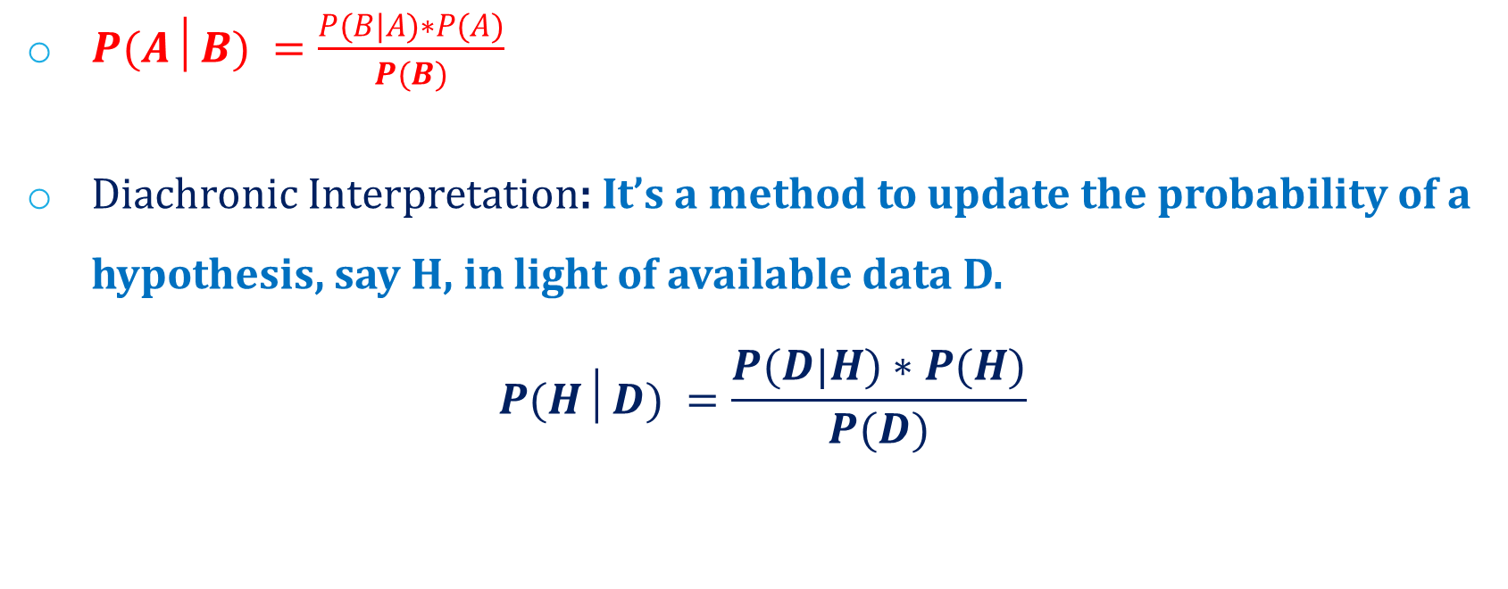
Bayes Theorem / Rule
$P(A│B) =\frac{P(B|A)∗P(A)}{P(B)}$
Diachronic Interpretation: It’s a method to update the probability of a hypothesis, say H, in light of available data D.
$$P(H│D) =\frac{P(D|H)∗P(H)}{P(D)}$$

Slide 12
Independent Events
Events A and B are said to be independent iff any of the three conditions are satisfied:
P(A∩B) = P(A) P(B)
P(A|B) = P(A)
P(B|A) = P(B)

Slide 13
Utility of Probability
To quantify a chanced occurrence such as
Express confidence in the prediction made
Express confidence in judgement made
Expression of confidence in Population Estimate
To decide which model gives better results
To judge how good is the model
…

Slide 14
Problem Solving : in class exercise
Suppose that an insurance company classifies people into one of three classes — good risks, average risks, and bad risks. Their records indicate that the probabilities that good, average, and bad risk persons will be involved in an accident over a 1-year span are, respectively, .05, .15, and .30. If 20% of the population are “good risks,” 50 %“average risks,” and 30% are “bad risks,” what proportion of people have accidents in a fixed year? If policy holder A had no accidents in 1987, what is the probability that he or she is a good (average) risk?

Slide 15
Thank you…

